Slide 1
for

Slide 2
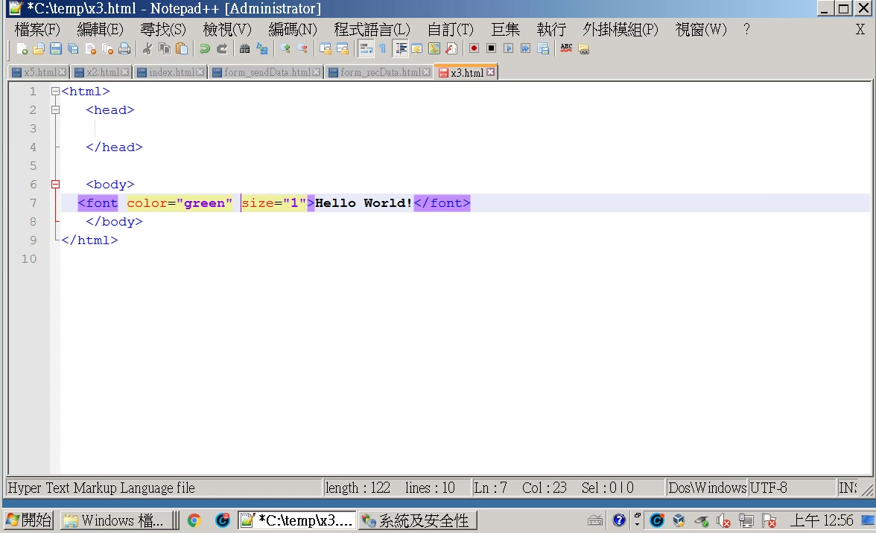

Slide 3
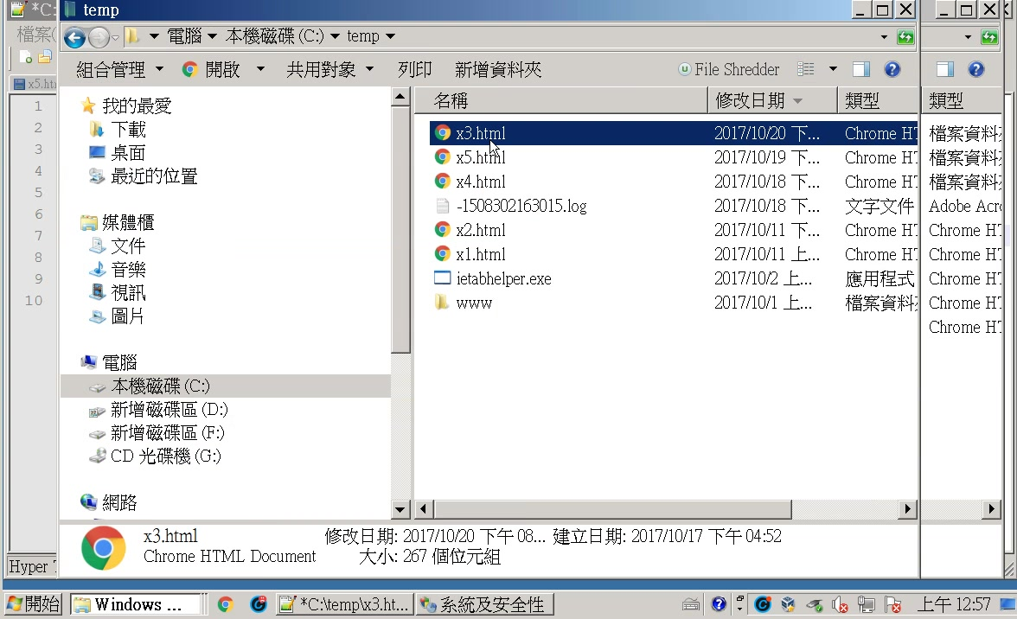

Slide 4
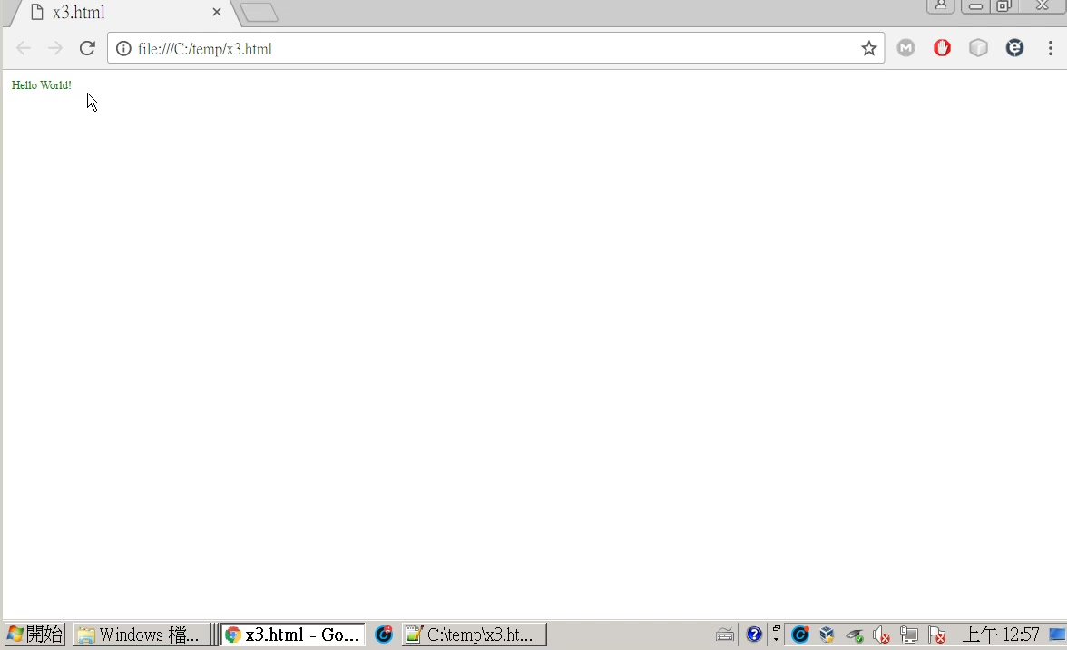

Slide 5
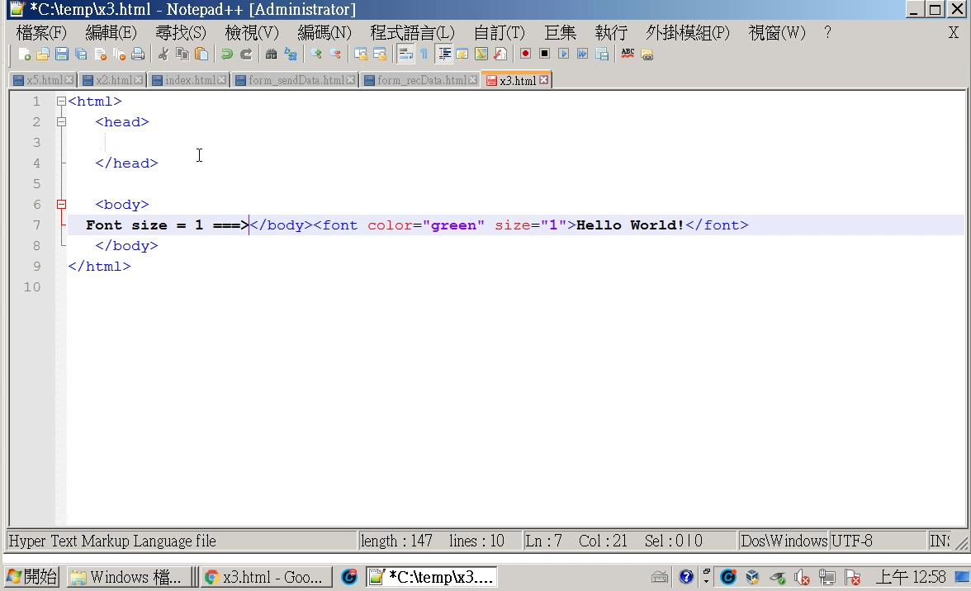

Slide 6
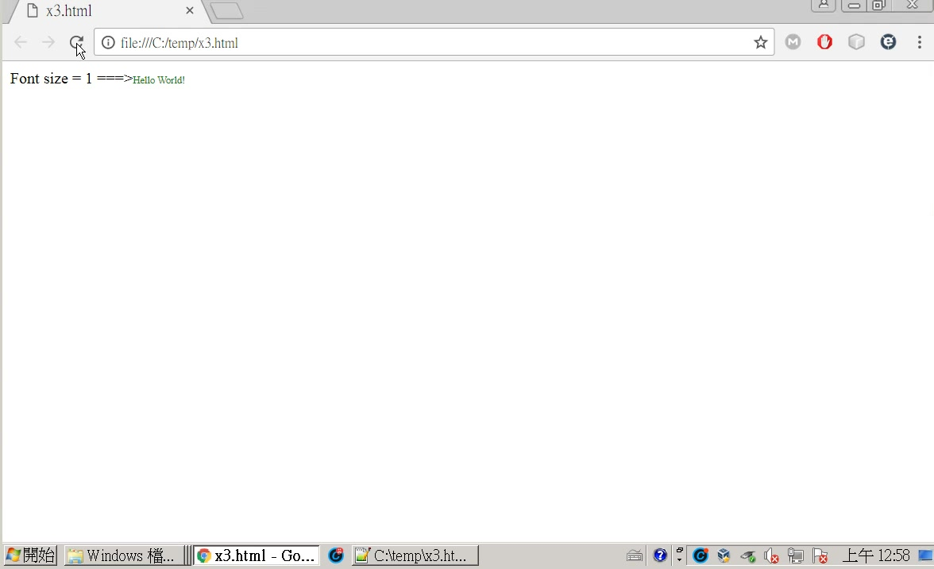

Slide 7
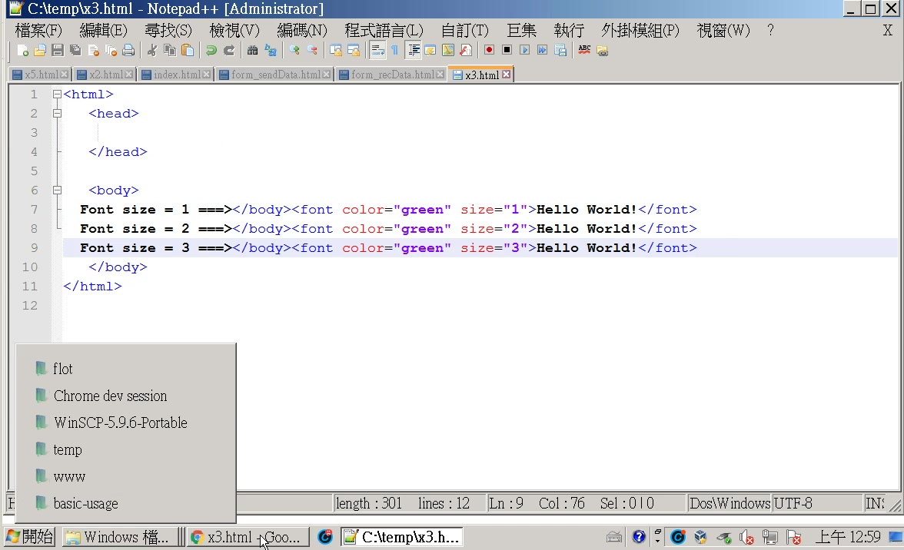

Slide 8
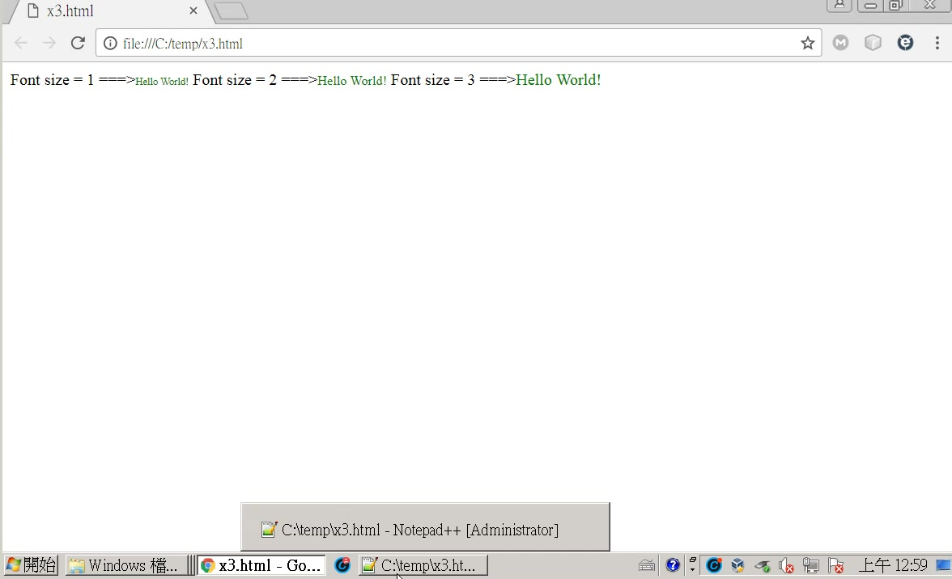

Slide 9
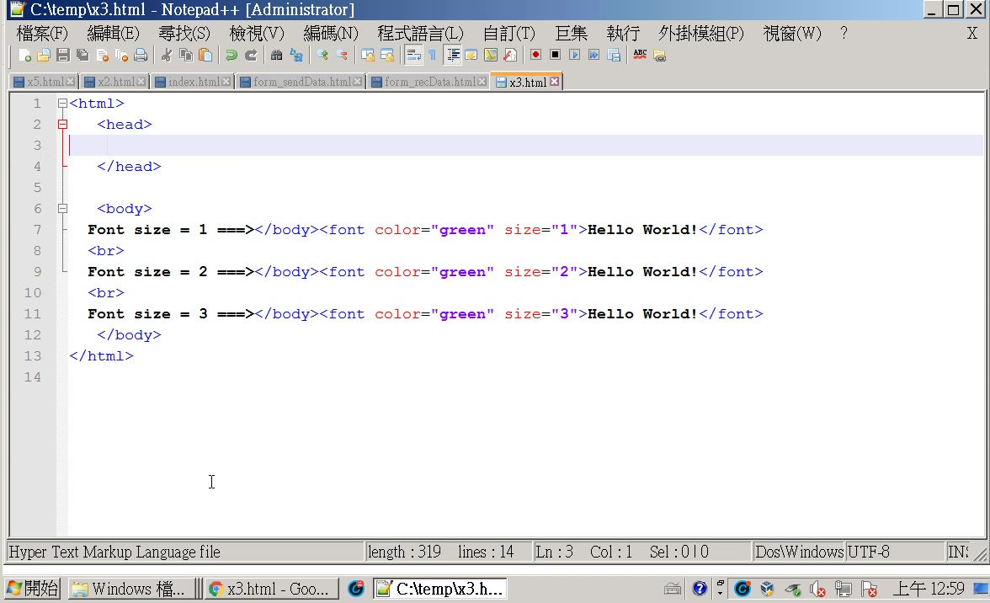

Slide 10
Font size = 1 ===></body><font color="green" size="1">Hello World!</font>
<br>
Font size = 2 ===></body><font color="green" size="2">Hello World!</font>
<br>
Font size = 3 ===></body><font color="green" size="3">Hello World!</font>

Slide 11
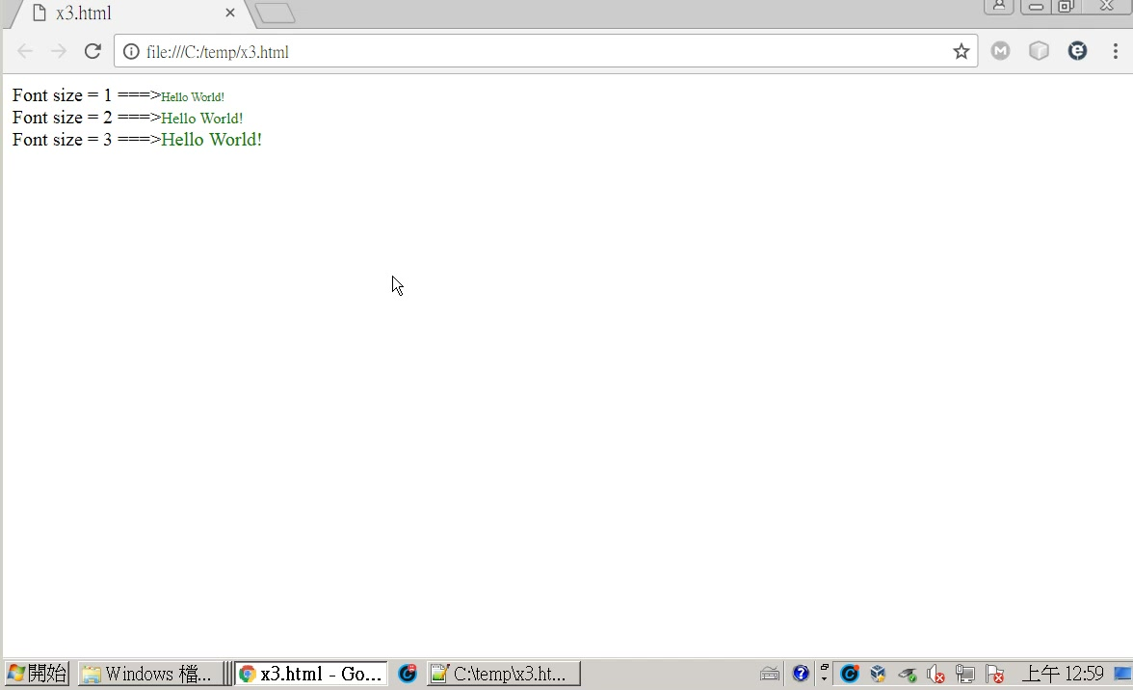

Slide 12
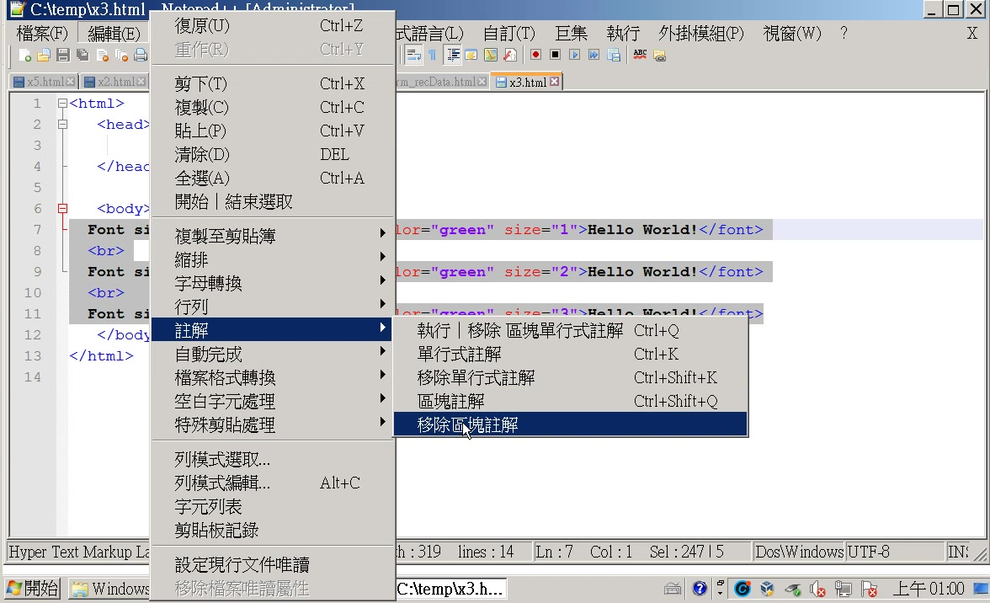

Slide 13
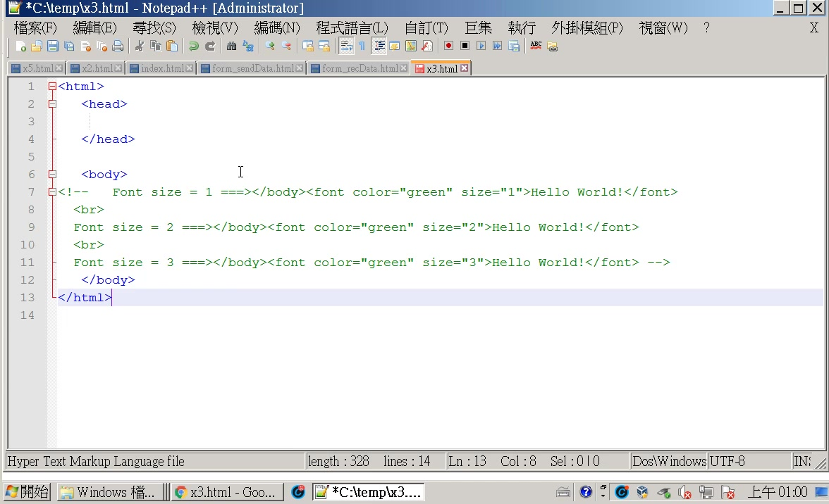

Slide 14
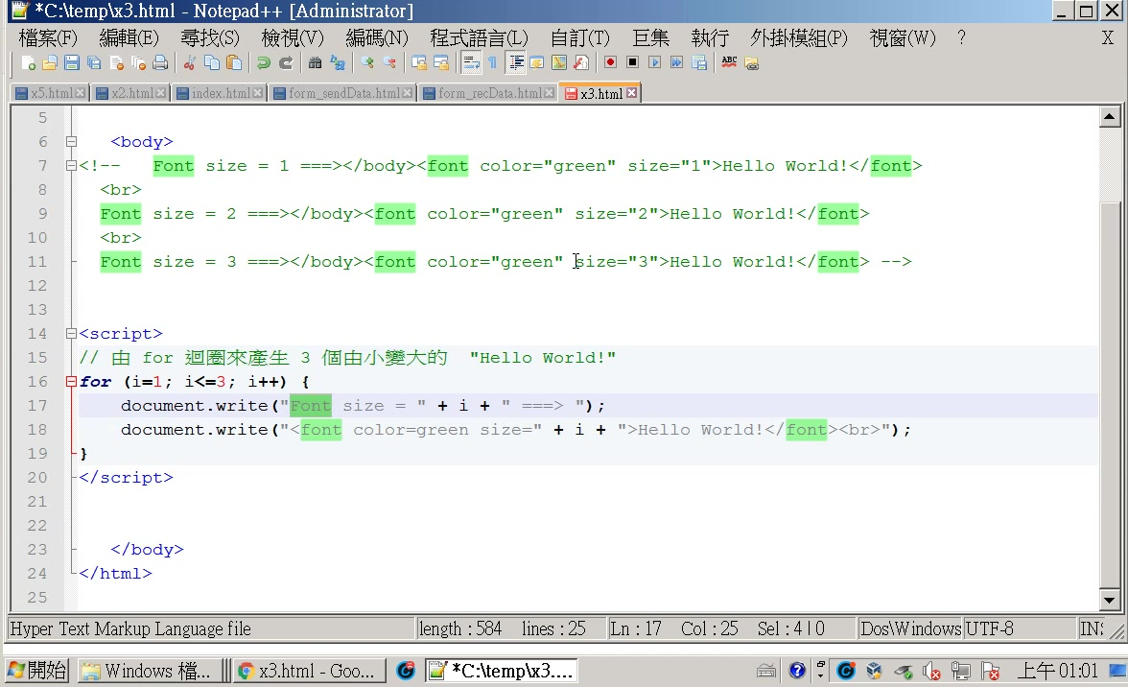

Slide 15
<html>
<head>
</head>
<body>
<!-- Font size = 1 ===></body><font color="green" size="1">Hello World!</font>
<br>
Font size = 2 ===></body><font color="green" size="2">Hello World!</font>
<br>
Font size = 3 ===></body><font color="green" size="3">Hello World!</font> -->
<script>
// 由 for 迴圈來產生 3 個由小變大的 "Hello World!"
for (i=1; i<=3; i++) {
document.write("Font size = " + i + " ===> ");
document.write("<font color=green size=" + i + ">Hello World!</font><br>");
}
</script>
</body>
</html>

Slide 16
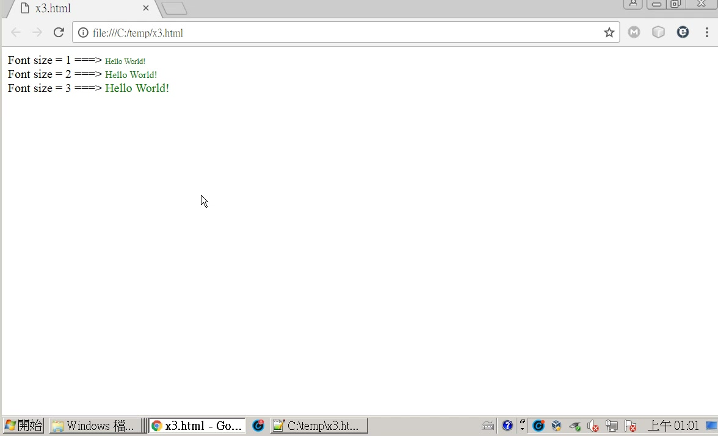

Slide 17
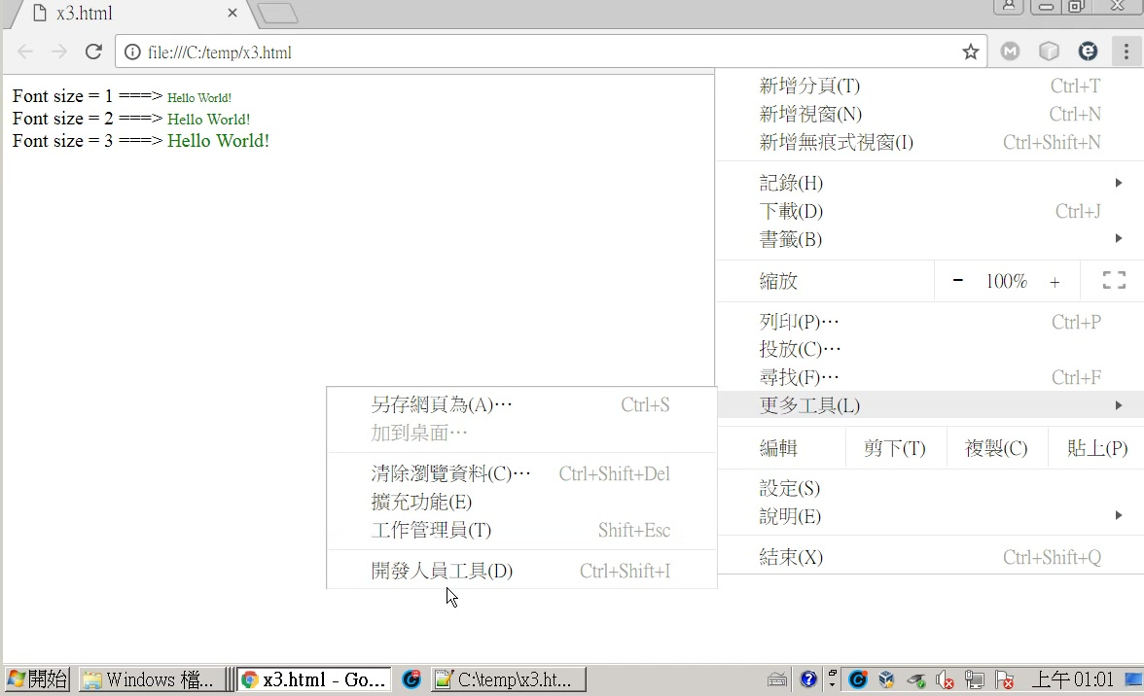

Slide 18
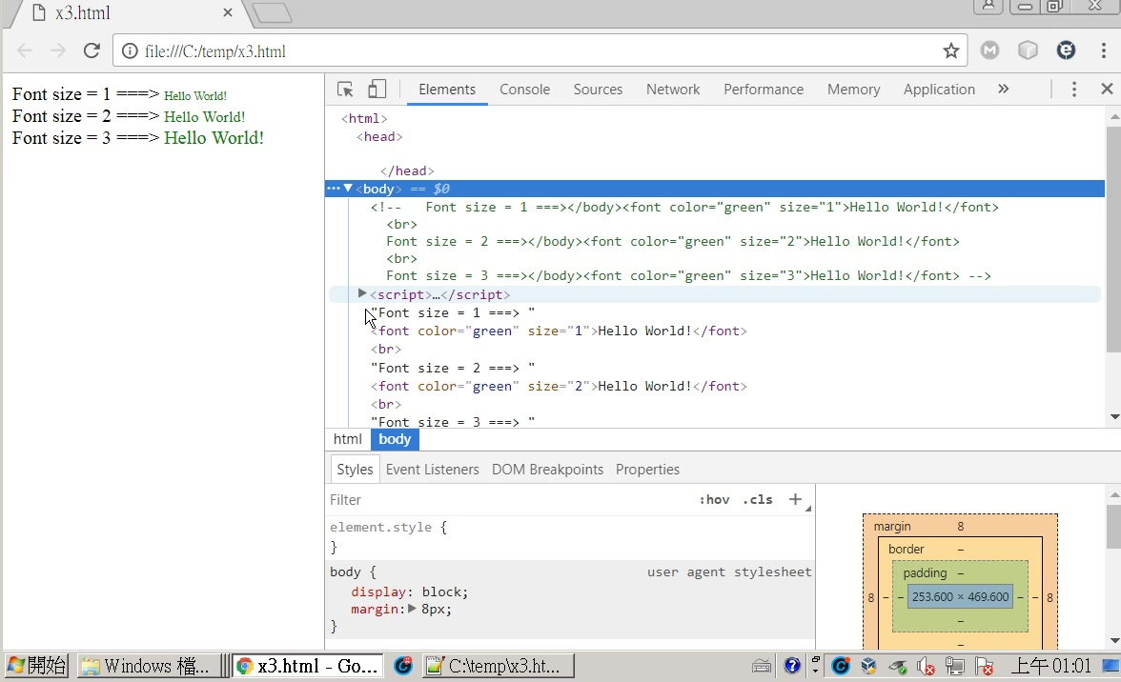
for迴圈在這裡
document.write
接在script block 之後。

